Slide 1
Vance Online Resources

Slide 2
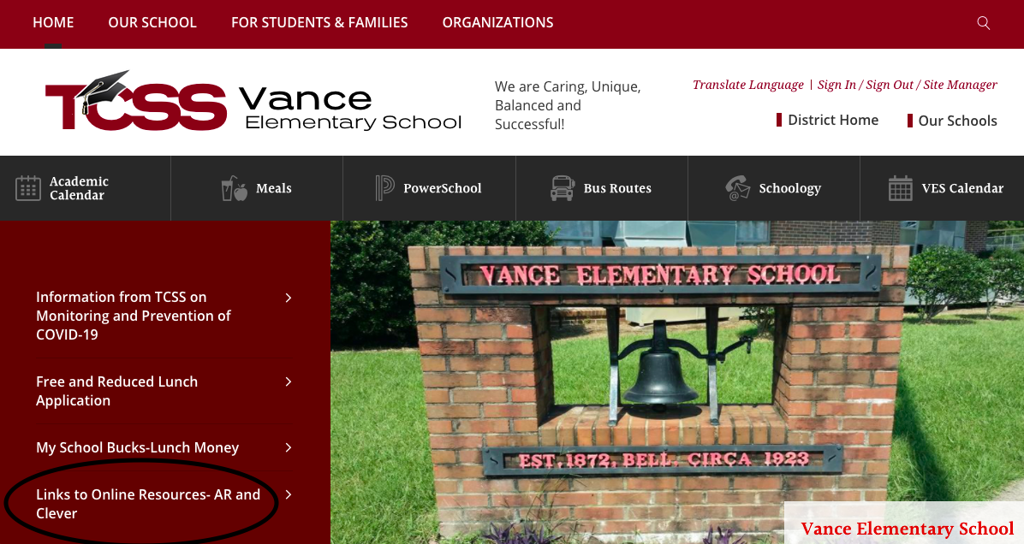
We will be looking at the online resources that are available for your child to use at school and at home.
Begin at the Vance Elementary website!
Click here to go to the VES website.
After you arrive at the VES website, click on the AR and Clever to go to online resources.
Notes:
Welcome parents to Vance Elementary's Virtually Vance night. This presentation has been created to help you as the parent of a student at Vance Elementary to be aware of the online resources available to use at school and at home.
The first step to access these resources is to search for the Vance Elementary School web page. Then you will click on the link that says "links to online resources".

Slide 3
Click here.
Notes:
Now you will click on the Clever link.

Slide 4
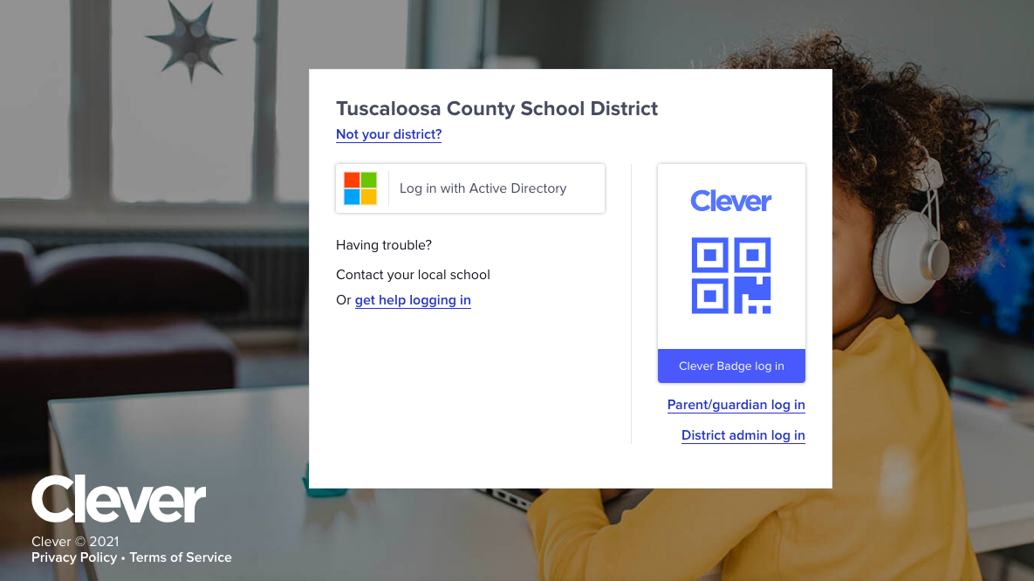
Click Clever badge login and scan child’s QR code
Or login with active directory with child’s username and password.
Your child’s teacher will provide this information.
Notes:
Once the Clever screen is visible, you can click on Scan the Clever badge option. Then you will hold your students Clever QR badge up to your camera or iphone camera and scan. Your child will then be logged into Clever.

Slide 5
After logging in to Clever you will see the apps available for your child to use.
Notes:
After scanning the Clever badge, you will see your student's name in the upper right hand corner of the page. You will also see many apps on the screen that your child has access to.

Slide 6
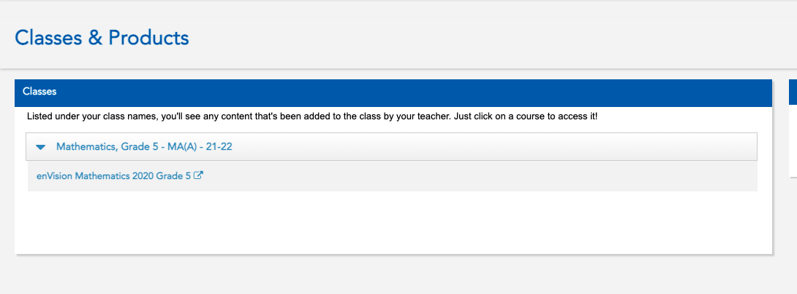
Math Resources
EnVision is our new math program. It combines problem-based learning and visual learning to deepen students’ conceptual understanding.
Click here to access additional math practice using the enVision math program. Students and parents are able to see grades from online assignments in the student portal. The online assessments are a great tool to help students prepare for the ACAP. Math games are located under the Tools section.
Notes:
EnVision Math is the new math program used by elementary schools in the TCSS . This program includes a online feature which provides students with extra practice directly from the math curriculum and lessons used in the classroom.

Slide 7
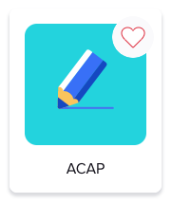
Testing Practice
This app will allow students to practice for the ACAP test.
Students complete the
I-Ready Pathways to practice math and reading skills .
Notes:
Students will be completing the ACAP test in the spring. The ACAP app allows them to observe the layout of the test and provides practice for the test.
I-Ready testing occurs throughout the school year. Student can work on the I-Ready pathways throughout the year so they will be more prepared for the tests.

Slide 8
Library and Reading Apps
Students use these apps to:
-review AR quiz scores and see books on your child's bookshelf which lists the books they have read and tested on
-search the VES library catalog and read from the Captsone ebook collection
-to read
e-books you will need your teacher's class code
-checkout and read e-books from TPL and VES ​
Notes:
Destiny is an app that can be used to search the VES library catalog. Students can also access the Capstone E-book collection from Destiny.
The AR/STAR login allows you to sign up for email notifications of an AR tests your students take at school, see their bookshelf of books read, and see their averages for AR scores and book levels read.
Epic is an app that provides e-books to students to read during the school day. You will need the teacher's class code to use this app. Last year this company provided this service for free but now there may be a small fee to access this at home.
SORA- This is an app that any student in the TCSS can access to checkout e-books. It is a free service that allows you to check out books from the TPL and our TCSS collection.

Slide 9
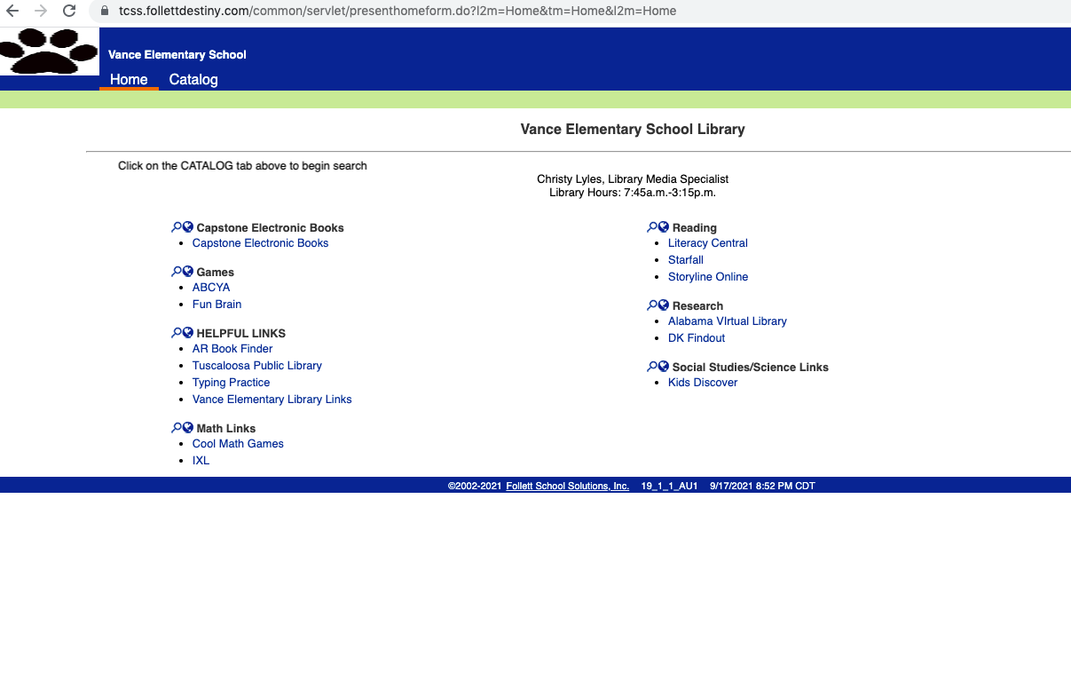
Destiny and Capstone e-books
Click here to search the VES catalog.
Testing Practice​
Click here to read Capstone e-books.
Notes:
This is Destiny. This is how anyone can search the VES catalog. You can also find the Captsone e-book collection link here. These books will read to your student. The books can also be AR tested on. Just write down the AR quiz # and when your student returns to school, they can login to AR and take the test using the AR quiz number.

Slide 10
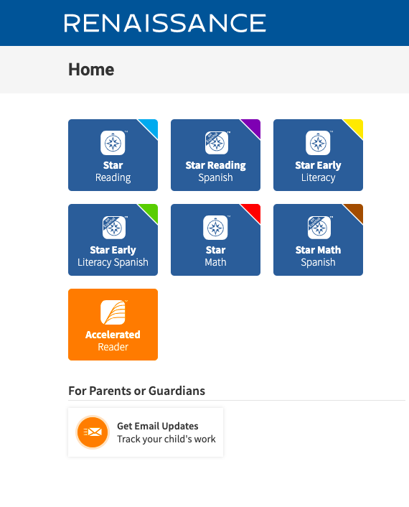
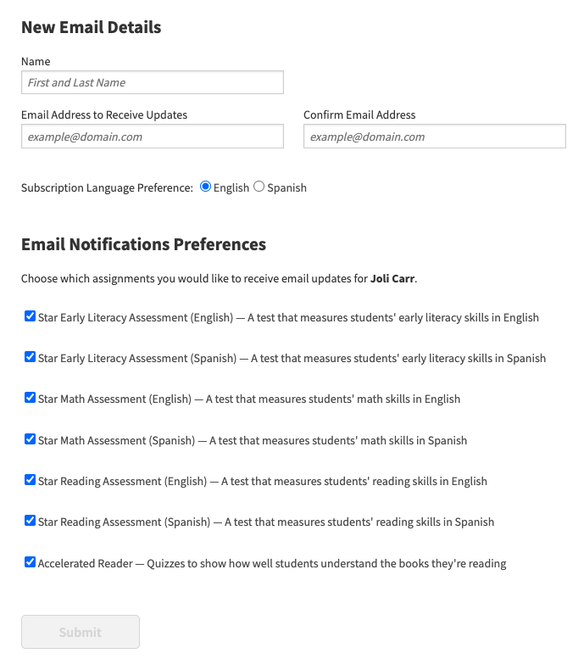
Accelerated Reader
Sign up for email notifications at home or work when your child completes an AR test. Click here to sign up.
Fill out online form and submit.
Click here to watch a parent's guide to using Renaissance Accelerated Reader
Notes:
This slide gives you explicit instructions on how to get signed up to AR Home Connect. A letter with all the vital information will be coming home this week.

Slide 11
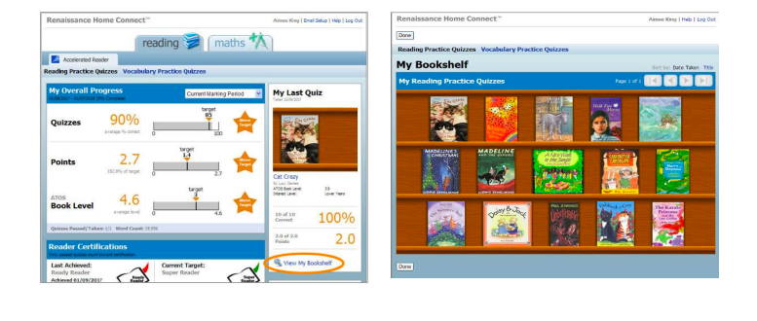
Accelerated Reader
Notes:
You will receive a personalized letter giving details of the web address to access Home Connect as well as your child’s login details. The screen on the left is the home screen for Home Connect. On this page, you can sign up for email notifications, see your child's average quiz score, points earned and book level. You can also click on view my bookshelf to see all the books your child has read. You can see an example of a bookshelf on the right side of the screen. You will also notice that if you need to find out the level of any book, you can click on the link AR Bookfinder and enter the book information to find out the level of any book.

Slide 12
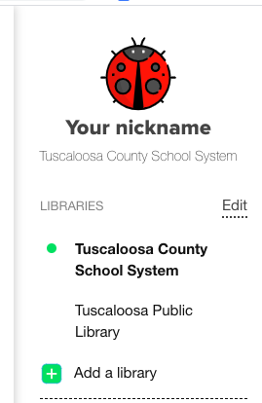
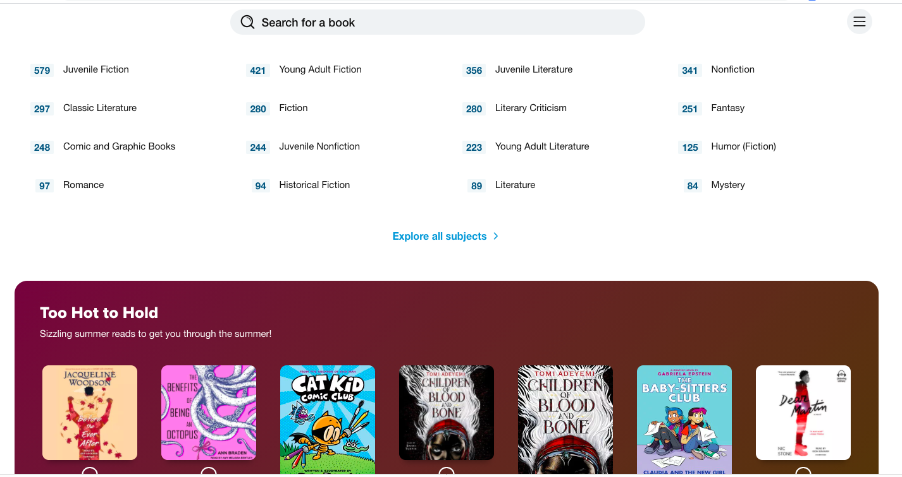
Sora
Notes:
SORA is the app that will allow your student to checkout our most popular titles from the TPL and from our TCSS collection. When you click on the SORA app you can select to choose from the TCSS collection or the TPL collection. Then you can search by genre or from the search box. These books can be read from any phone, tablet, or computer at home or at school.

Slide 13
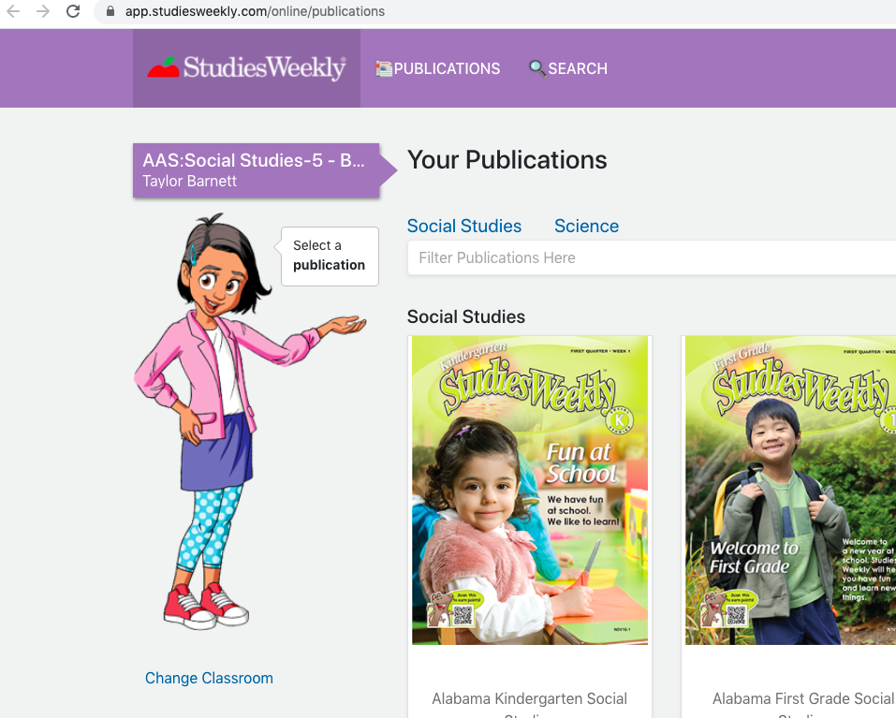
Science and Social Studies Resources
Notes:
Studies Weekly is like the Weekly Readers of the past. They are specific for your child's grade level and cover science and social studies topics. They are also accessed through Clever.

Slide 14
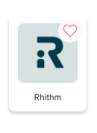
Rhithm App-Social/Emotional Health
Students simply answer 5 questions about how they are feeling and it gives them a video based on their emotions.
Notes:
The Rhithm app helps students address their social emotional needs. They answer several questions about their current feelings and the program provides helpful videos to improve their well-being for the day, week, and for a lifetime.

Slide 15
If you have further questions, please contact :
Christy Lyles
clyles@tcss.net
(205)342-2697 ext.4
Notes:
If you have any questions about the programs reviewed, please email Clyles@tcss.net. If you are in need of a Clever QR badge or password needed for a certain program, please contact your child's teacher. Thank you for taking the time to help your child excel at school and to learn more about the online learning opportunities provided to your student.

